Slide 1





MovieRoulette
A HYBRID CHATBOT RECOMMENDER SYSTEM FOR RECOMMENDING MOVIES
GROUP 10
DEEPANRAJ, KEERTHIVASAN, RANJITKUMAR, SRUTI

Slide 2
PROBLEM FORMULATION
“Serendipity” – this is the major concern when it comes to most of the movie recommender systems.
Users are often shocked to see movies which they dislike (preferably genres) being recommended to them.
To overcome these issues, most recommender systems use a hybrid technique in which they use both collaborative and content-based filtering, and they are mostly based on user ratings and reviews.
But we have gone another step forward to introduce another filtering technique called genre-based filtering .

Slide 3

HYPOTHESIS
Hypothesis 1: “Do not recommend the same movies which the user has mentioned to be interesting.”
Hypothesis 2: “Do not recommend any movie which belongs to the disliked genre of the user.”

Slide 4
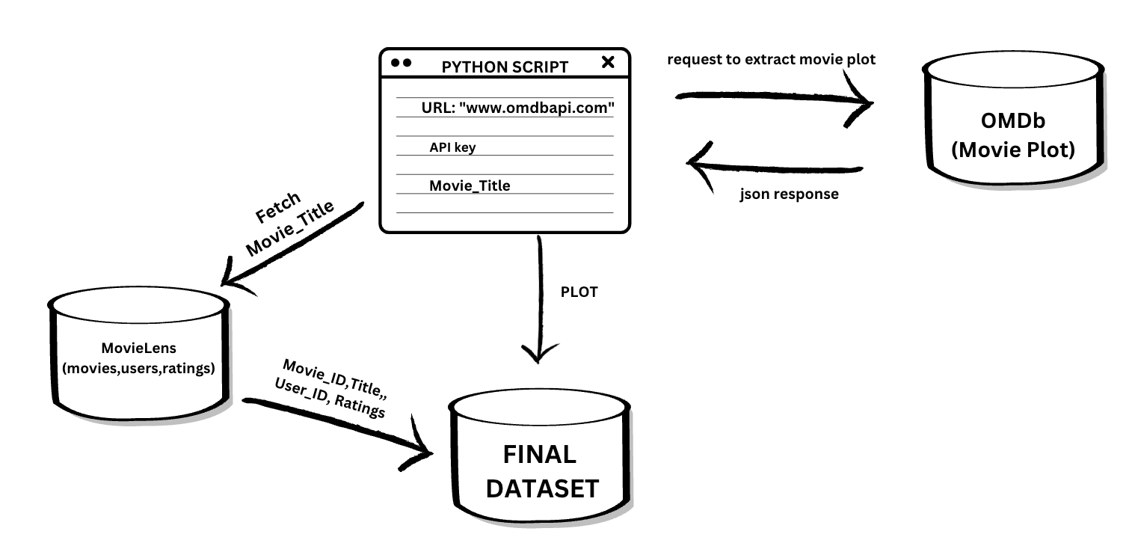
DATA PREPARATION

Slide 5
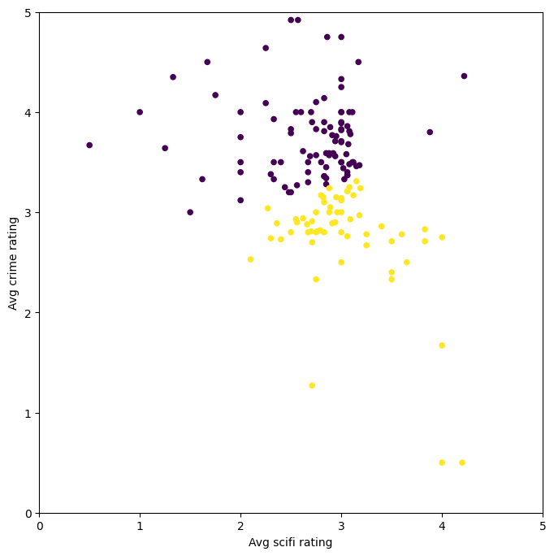
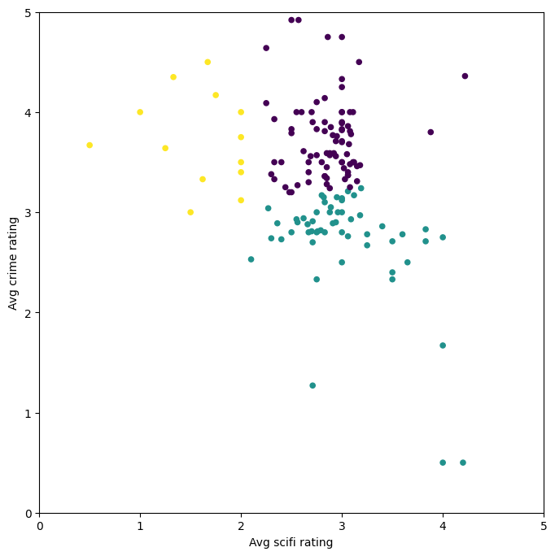
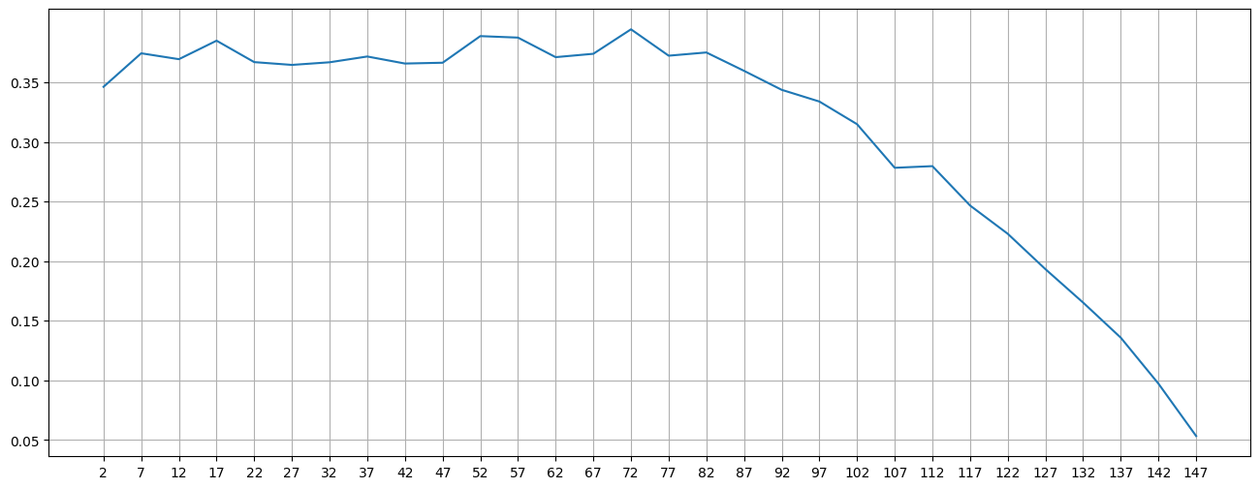
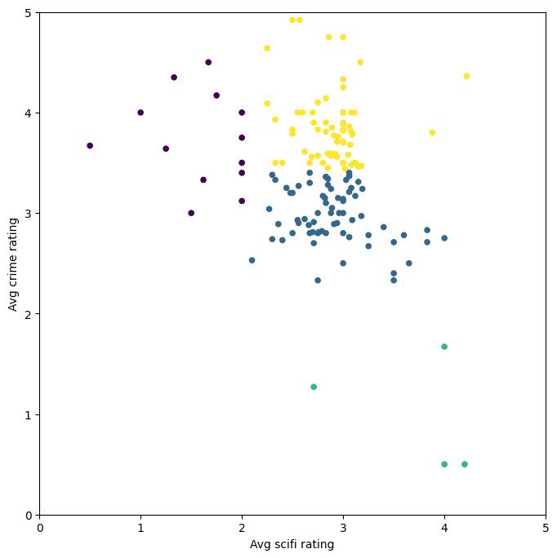
DATA INSIGHTS - CLUSTERING
To perform clustering, we utilised the K means clustering and used the Silhouette scores to evaluate the best K value (Number of Clusters)
K=2
K=3
PLOTTING K VALUES TO THEIR CORRESPONDING SILHOUTTE SCORES
K=7 IS FOUND TO BE THE GOOD CHOICE
K=4

Slide 6
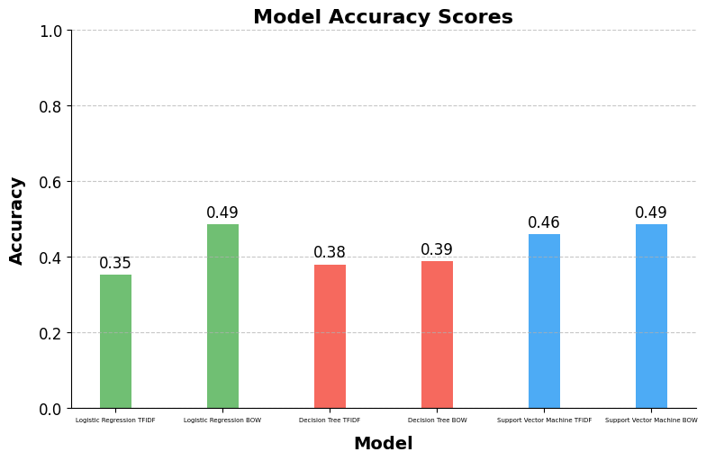
DATA INSIGHTS - CLASSIFICATION
CLASSIFICATION MODELS USED – LOGISTIC REGRESSION, DECISION TREE, SVM
Classification models with Bag of Words as the Feature Extraction Method gave better results than TF-IDF.
So, in content-based filtering, BOW is used for extracting text from the plot summaries of the movies.

Slide 7
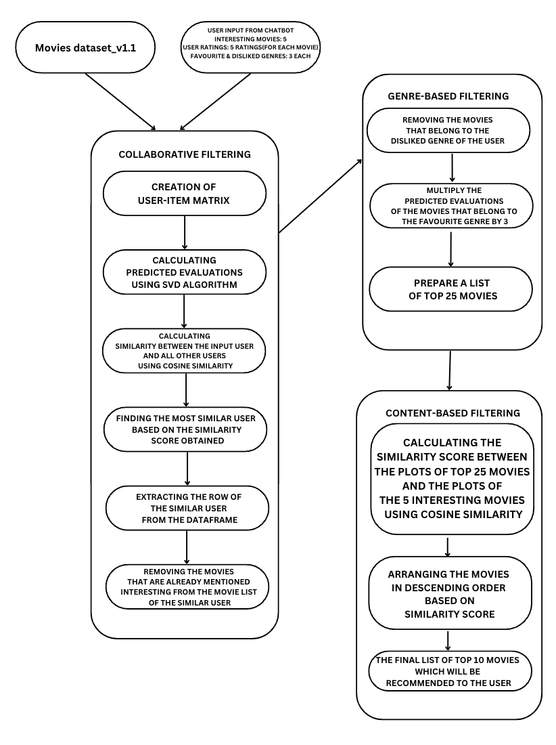
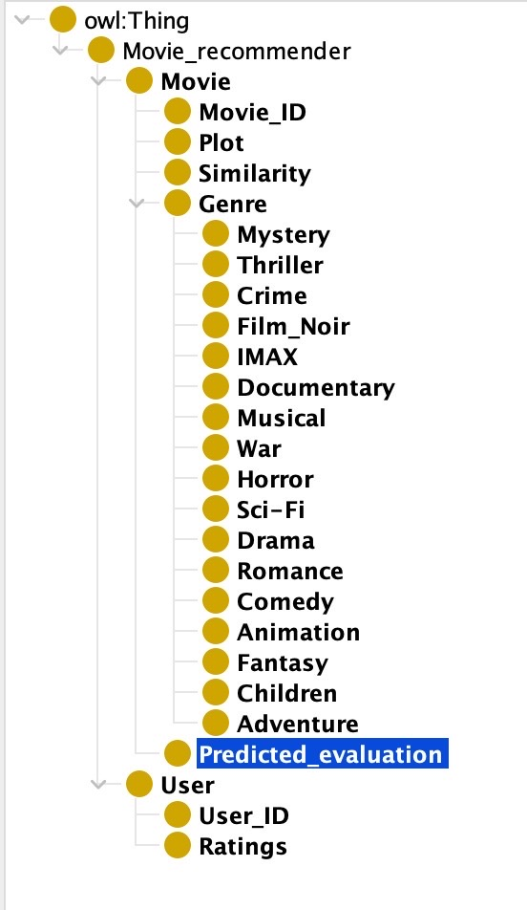
ONTOLOGY & SYSTEM ARCHITECTURE

Slide 8
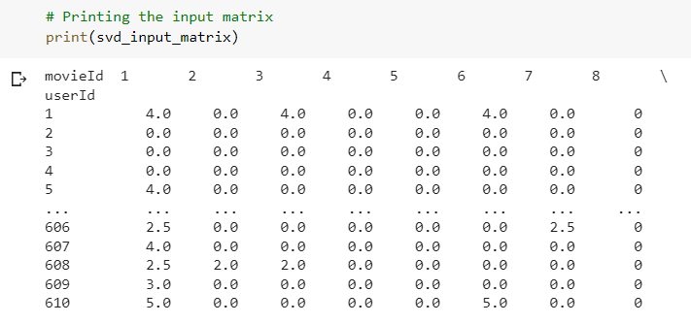
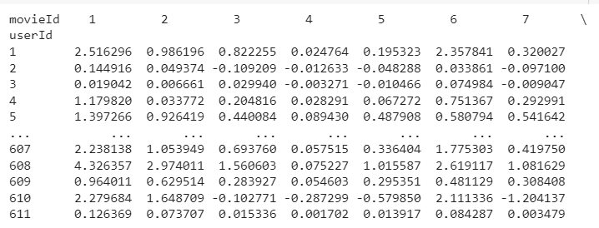

COLLABORATIVE FILTERING
After performing SVD on
the User-Item Matrix

Slide 9
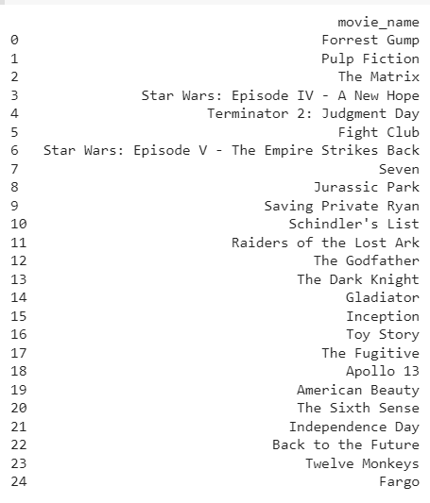
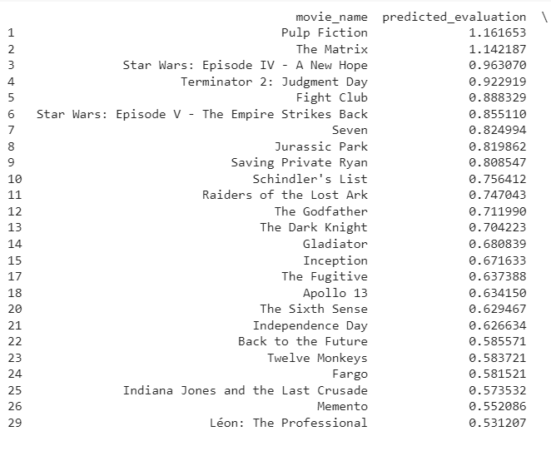


GENRE-BASED FILTERING

Slide 10
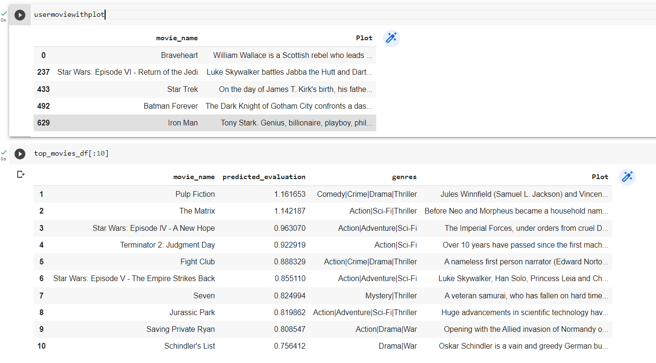
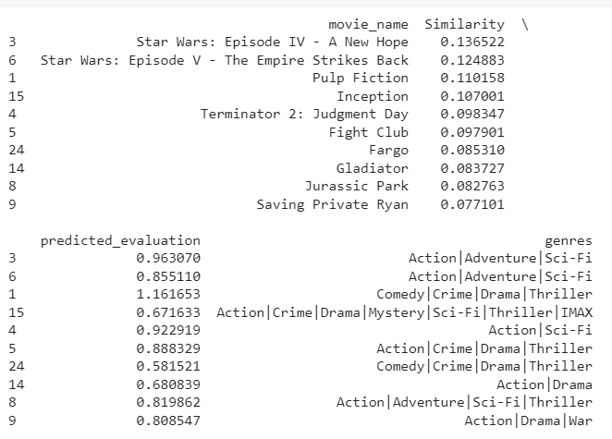

CONTENT-BASED FILTERING

Slide 11
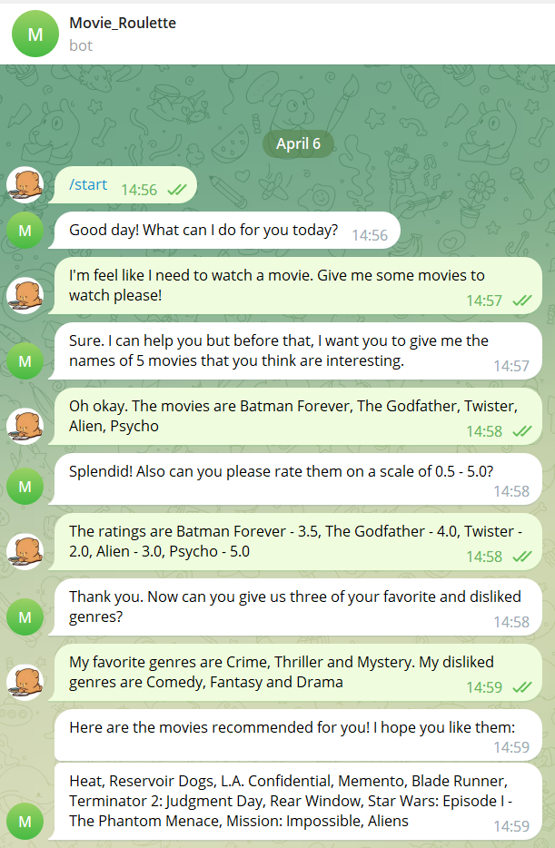
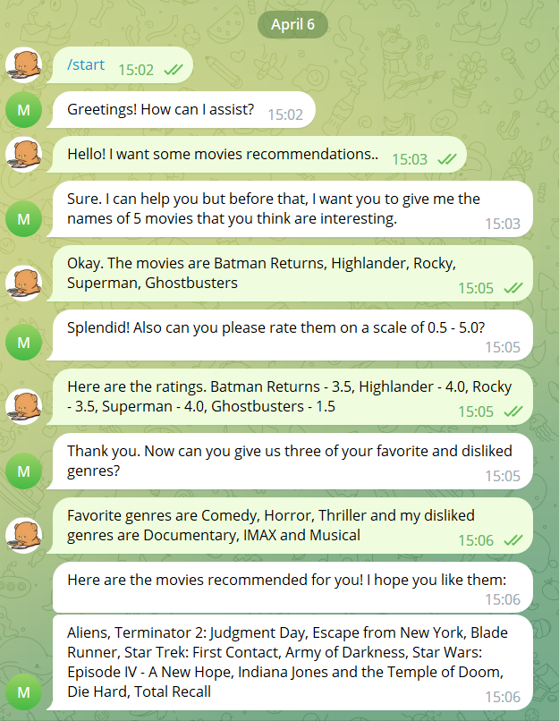
RESULTS

Slide 12


